Slide 1
Introduction to Matlab
By: İ.Yücel Özbek

Slide 2
Outline:
What is Matlab?
Matlab Screen
Variables, array, matrix, indexing
Operators (Arithmetic, relational, logical )
Display Facilities
Flow Control
Using of M-File
Writing User Defined Functions
Conclusion

Slide 3
What is Matlab?
Matlab is basically a high level language which has many specialized toolboxes for making things easier for us
How high?
Matlab
High Level
Languages such as
C, Pascal etc.
Assembly

Slide 4
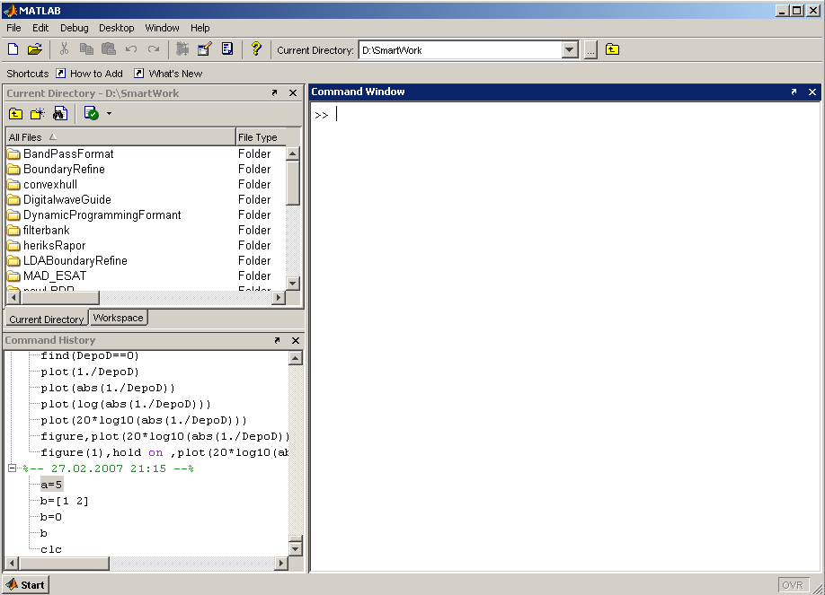
Matlab Screen
Command Window
type commands
Current Directory
View folders and m-files
Workspace
View program variables
Double click on a variable
to see it in the Array Editor
Command History
view past commands
save a whole session
using diary

Slide 5
Variables
No need for types. i.e.,
All variables are created with double precision unless specified and they are matrices.
After these statements, the variables are 1x1 matrices with double precision
int a;
double b;
float c;
Example:
>>x=5;
>>x1=2;

Slide 6
Array, Matrix
a vector x = [1 2 5 1]
x =
1 2 5 1
a matrix x = [1 2 3; 5 1 4; 3 2 -1]
x =
1 2 3
5 1 4
3 2 -1
transpose y = x’ y =
1
2
5
1

Slide 7
Long Array, Matrix
t =1:10
t =
1 2 3 4 5 6 7 8 9 10
k =2:-0.5:-1
k =
2 1.5 1 0.5 0 -0.5 -1
B = [1:4; 5:8]
x =
1 2 3 4
5 6 7 8

Slide 8
Generating Vectors from functions
zeros(M,N) MxN matrix of zeros
ones(M,N) MxN matrix of ones
rand(M,N) MxN matrix of uniformly distributed random
numbers on (0,1)
x = zeros(1,3)
x =
0 0 0
x = ones(1,3)
x =
1 1 1
x = rand(1,3)
x =
0.9501 0.2311 0.6068

Slide 9
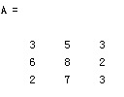
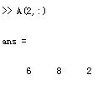



Matrix Index
The matrix indices begin from 1 (not 0 (as in C))
The matrix indices must be positive integer
Given:
A(-2), A(0)
Error: ??? Subscript indices must either be real positive integers or logicals.
A(4,2)
Error: ??? Index exceeds matrix dimensions.

Slide 10
Concatenation of Matrices
x = [1 2], y = [4 5], z=[ 0 0]
A = [ x y]
1 2 4 5
B = [x ; y]
1 2
4 5
C = [x y ;z]
Error:
??? Error using ==> vertcat CAT arguments dimensions are not consistent.

Slide 11
Operators (arithmetic)
+ addition
- subtraction
* multiplication
/ division
^ power
‘ complex conjugate transpose

Slide 12
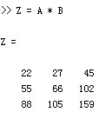
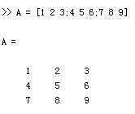
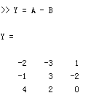
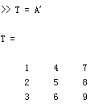
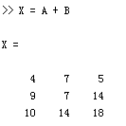
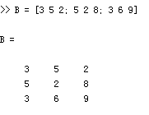
Matrices Operations
Given A and B:
Addition
Subtraction
Product
Transpose

Slide 13
Operators (Element by Element)
.* element-by-element multiplication
./ element-by-element division
.^ element-by-element power

Slide 14
The use of “.” – “Element” Operation
A = [1 2 3; 5 1 4; 3 2 1]
A =
1 2 3
5 1 4
3 2 -1
b = x .* y
b=
3 8 -3
c = x . / y
c=
0.33 0.5 -3
d = x .^2
d=
1 4 9
x = A(1,:)
x=
1 2 3
y = A(3 ,:)
y=
3 4 -1
K= x^2
Erorr:
??? Error using ==> mpower Matrix must be square.
B=x*y
Erorr:
??? Error using ==> mtimes Inner matrix dimensions must agree.

Slide 15
Basic Task: Plot the function sin(x) between 0≤x≤4π
Create an x-array of 100 samples between 0 and 4π.
Calculate sin(.) of the x-array
Plot the y-array
>>x=linspace(0,4*pi,100);
>>y=sin(x);
>>plot(y)

Slide 16
Plot the function e^{-x/3}sin(x) between 0≤x≤4π
Create an x-array of 100 samples between 0 and 4π.
Calculate sin(.) of the x-array
Calculate e^{-x/3} of the x-array
Multiply the arrays y and y1
>>x=linspace(0,4*pi,100);
>>y=sin(x);
>>y1=exp(-x/3);
>>y2=y*y1;

Slide 17
Plot the function e^{-x/3}sin(x) between 0≤x≤4π
Multiply the arrays y and y1 correctly
Plot the y2-array
>>y2=y.*y1;
>>plot(y2)

Slide 18
Display Facilities
plot(.)
stem(.)
Example:
>>x=linspace(0,4*pi,100);
>>y=sin(x);
>>plot(y)
>>plot(x,y)
Example:
>>stem(y)
>>stem(x,y)

Slide 19
Display Facilities
title(.)
xlabel(.)
ylabel(.)
>>title(‘This is the sinus function’)
>>xlabel(‘x (secs)’)
>>ylabel(‘sin(x)’)

Slide 20
Operators (relational, logical)
== Equal to
~= Not equal to
< Strictly smaller
> Strictly greater
<= Smaller than or equal to
>= Greater than equal to
& And operator
| Or operator

Slide 21
Flow Control
if
for
while
break
….

Slide 22
Control Structures
Some Dummy Examples
if ((a>3) & (b==5))
Some Matlab Commands;
end
if (a<3)
Some Matlab Commands;
elseif (b~=5)
Some Matlab Commands;
end
if (a<3)
Some Matlab Commands;
else
Some Matlab Commands;
end
If Statement Syntax
if (Condition_1)
Matlab Commands
elseif (Condition_2)
Matlab Commands
elseif (Condition_3)
Matlab Commands
else
Matlab Commands
end

Slide 23
Control Structures
Some Dummy Examples
for i=1:100
Some Matlab Commands;
end
for j=1:3:200
Some Matlab Commands;
end
for m=13:-0.2:-21
Some Matlab Commands;
end
for k=[0.1 0.3 -13 12 7 -9.3]
Some Matlab Commands;
end
For loop syntax
for i=Index_Array
Matlab Commands
end

Slide 24
Control Structures
While Loop Syntax
while (condition)
Matlab Commands
end
Dummy Example
while ((a>3) & (b==5))
Some Matlab Commands;
end

Slide 25
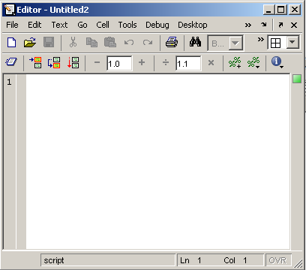
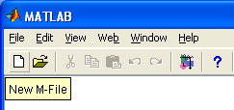
Use of M-File
Click to create a new M-File
Extension “.m”
A text file containing script or function or program to run

Slide 26
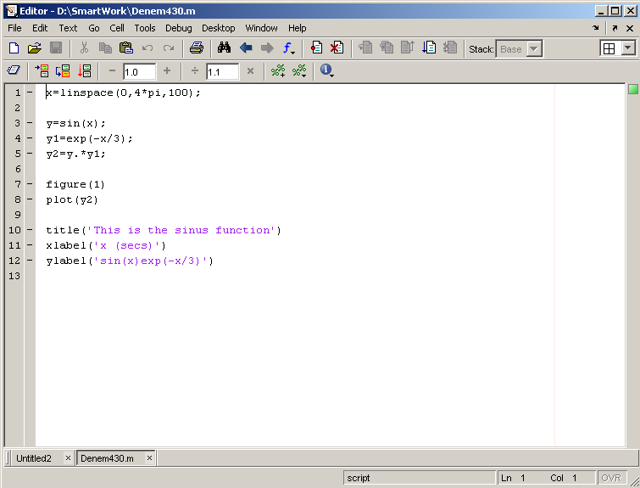
Use of M-File
Save file as Denem430.m
If you include “;” at the
end of each statement,
result will not be shown
immediately

Slide 27
Writing User Defined Functions
Functions are m-files which can be executed by specifying some inputs and supply some desired outputs.
The code telling the Matlab that an m-file is actually a function is
You should write this command at the beginning of the m-file and you should save the m-file with a file name same as the function name
function out1=functionname(in1)
function out1=functionname(in1,in2,in3)
function [out1,out2]=functionname(in1,in2)

Slide 28
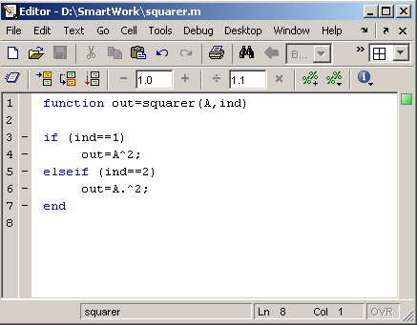
Writing User Defined Functions
Examples
Write a function : out=squarer (A, ind)
Which takes the square of the input matrix if the input indicator is equal to 1
And takes the element by element square of the input matrix if the input indicator is equal to 2
Same Name

Slide 29
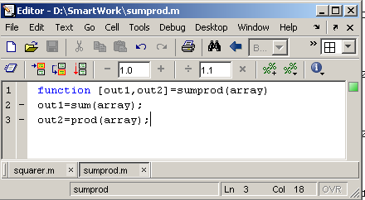
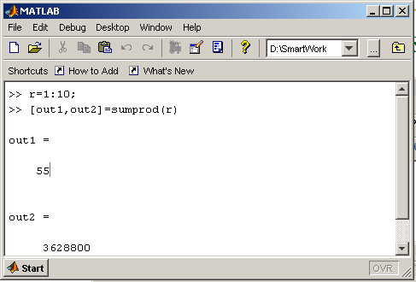
Writing User Defined Functions
Another function which takes an input array and returns the sum and product of its elements as outputs
The function sumprod(.) can be called from command window or an m-file as

Slide 30
Notes:
“%” is the neglect sign for Matlab (equaivalent of “//” in C). Anything after it on the same line is neglected by Matlab compiler.
Sometimes slowing down the execution is done deliberately for observation purposes. You can use the command “pause” for this purpose
pause %wait until any key
pause(3) %wait 3 seconds

Slide 31
Useful Commands
The two commands used most by Matlab
users are
>>help functionname
>>lookfor keyword

Slide 32
Questions
?
?
?
?
?

Slide 33
Thank You…

